Slide 1

Heartbeat classification
Guido Gagliardi
Matteo dessi’

Slide 2
Heartbeat classification
The aim of this project is to use Machine Learning, using Python, to build several models that will be able to predict the presence of an arythmia from an ECG signal.
The ML models will classify each beat constituting an ECG signal into one of the four most important macro-classis of arythmia: N, VEB, SVEB and F.
5 different models were trained and tested and their performance compared
The data employed belongs entirely to the MIT-BH database

Slide 3
DATASET
Explanation of the MIT-bih db

Slide 4
DATASET: Mit-BIH DataBASE
The MIT-BIH Arrhythmia Database contains 48 half-hour excerpts of two-channel ambulatory ECG recordings, obtained from 47 subjects studied by the BIH Arrhythmia Laboratory between 1975 and 1979.
Each ECG record contains a variable number of beats, these usually vary patient by patient, and are refered to one txt file containing the information about the beats.
Each beat has two files associated to it:
Txt file, containing in particular the position of the peak and the class to which the beat has been labeled
CSV file, formed by two columns:
Value of the MLII (modified-lead II)
Value of one of V1,V2,V4 or V5

Slide 5
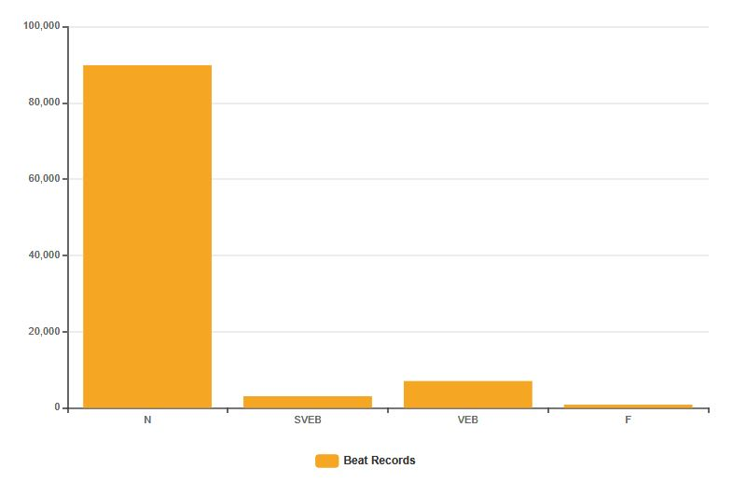
DATASET: CLASS DIAGRAM
Each beat is sampled from the database using the information of its peak and taking a certain number of values from the ECG wave by the left and the right of the peak.
Each beat it is sampled in both of the signal stored in the CSV columns ( MLII and V1 ) and stored again in 2 vector of 360 values representing the y values of the ECG wave.
The dataset is highly imbalanced:
90% of the beats belong to class N
3% belong to class SVEB
6% belong to class VEB
1% belong to class F
The Q AAMI classes have been
ignored given their basically
non-existance

Slide 6
Preprocessing
ECG WAVES DATABASE
CSV
BEATS
DATABASE
MIT-BIH
DATABASE
PREPROCESSING
PEAKS DATABASE
( TXT )
Data Sampling
- 2 beat data records
- peak position
- beat classification
Some preprocessing has been performed on the dataset before the training, in order to remove noise and clean data.
The procedure consists in performing a baseline removal from both of the 2 beat records:
Two median filters of 200 ms and 600 ms are applied to obtain a baseline
This baseline is substracted to the original signal, obtaining the baseline corrected ecg signal
Furthemore a normalization step of the data has been provided before the classification step.

Slide 7
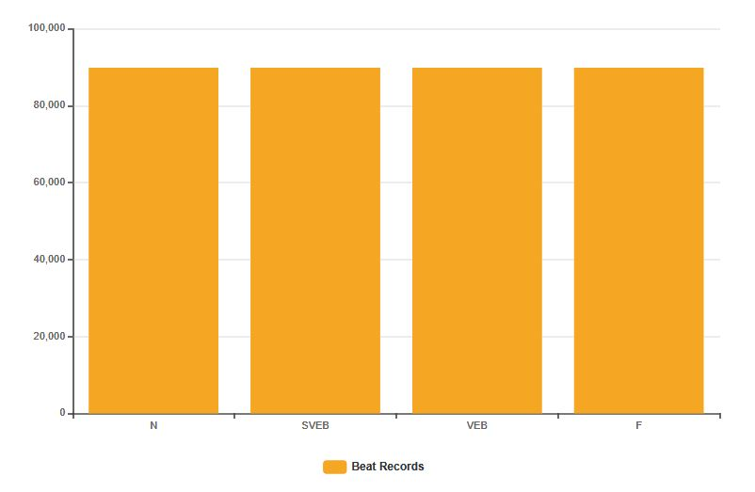
OVERSAMPLING
Given the high unbalance of the database, a step of oversampling for the minority classes is necessary
Two metods:
Artifical Oversample: Taking a point from the segment uniting a point in the dataset and one of its k-neighbors
Random Oversample: Picking samples at random with replacement
PREPROCESSING
OVERSAMPLING
Artificial Oversample
Random Oversample

Slide 8
Classification
Models training using beat as data input

Slide 9
CLASSIFICATION: MODELS
5 Classification Models are tested for the Arythmia Classification Task
CART - ( C4.5 implementation in python scikit-learn )
Naive Bayesian
K-NN
SVM
RandomForest
Since that each beat has 2 rapresentation sampled by different ECG waves ( MLII and V1 ) in a first step each kind of beat is used to train a different classifier and their performances compared.
In a second step both of the beats type are used togheter to form a unique data mining flow in order to improve the performances of the clasifiers.

Slide 10
CLASSIFICATION: 6 FOLD VALIDATION
In order to provide relevant data for the classification task a k-fold validation has been performed.
It is decided to use 6-fold while each fold is a patient ECG record ( with both of MLII and V1 ).
Each of the step in the dataming flow is wrapped in the 6 fold classification method, from the normalization of the data ( the scaler is fitted with the training folds and then used on the test fold), to the classification.

Slide 11
Classification: DATA MINING FLOW
MLII
CLASSIFICATION
DATABASE
PREPROCESSING
OVERSAMPLING
V1
CLASSIFICATION

Slide 12
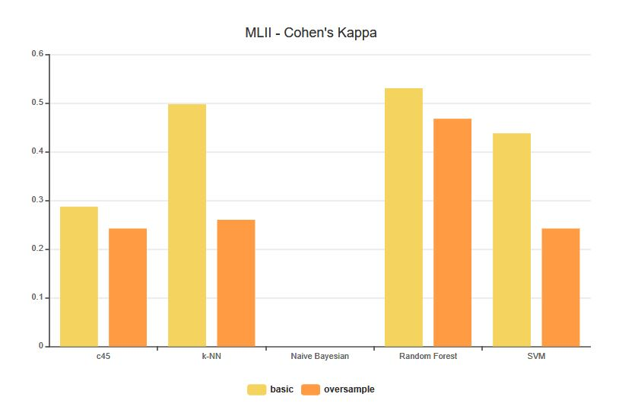
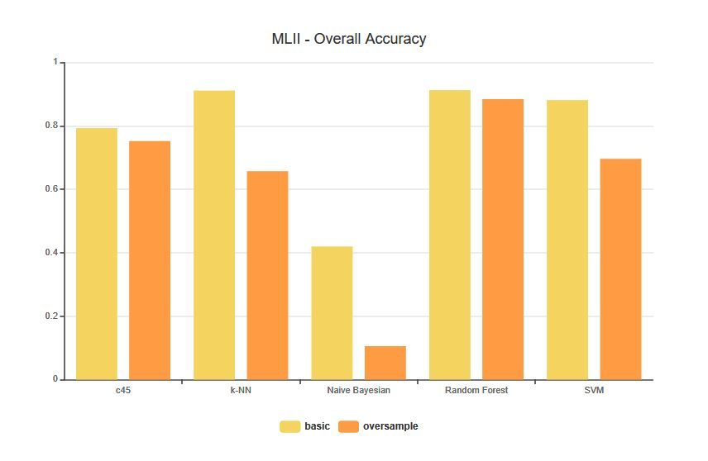
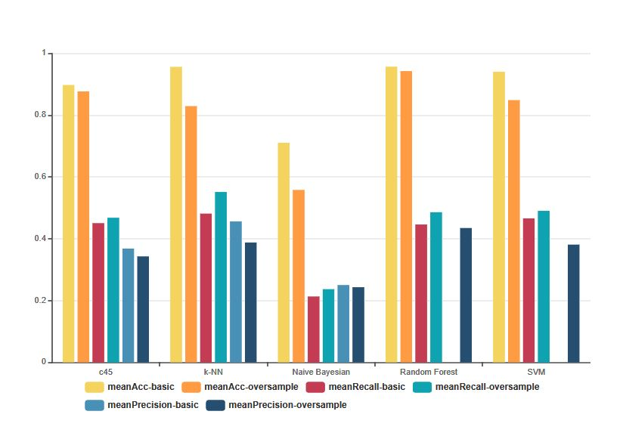
CLASSIFICATION: I - MODELS EVALUATION WITH BEAT AS DATA - MLII

Slide 13
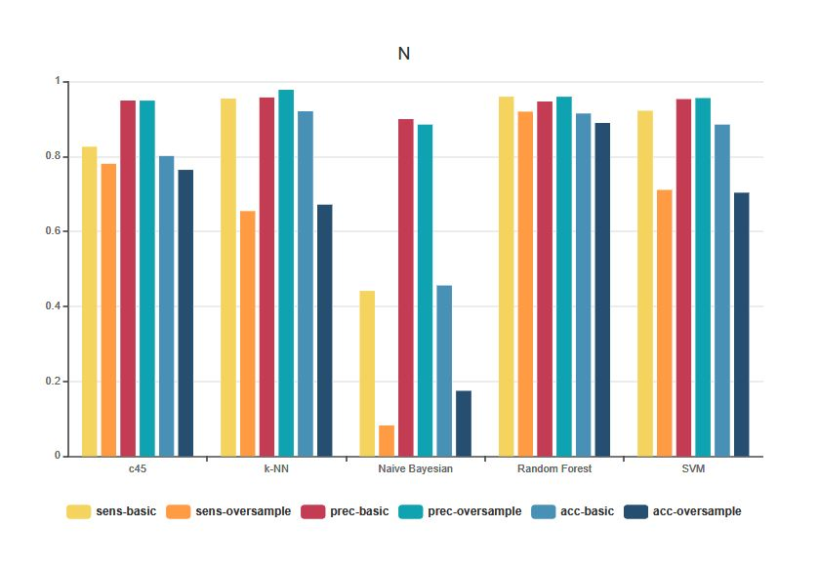
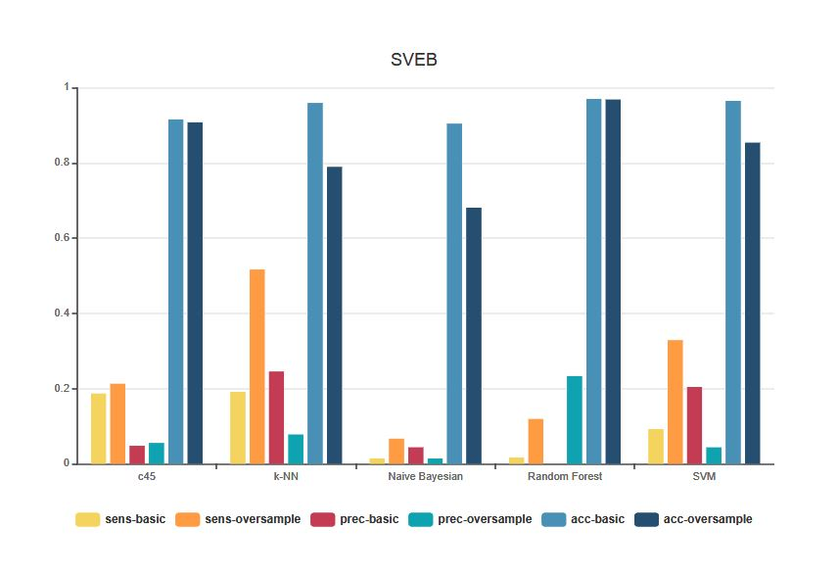
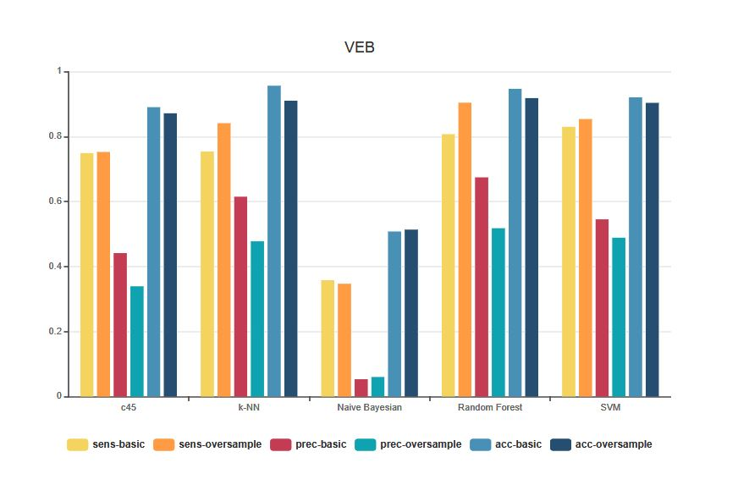
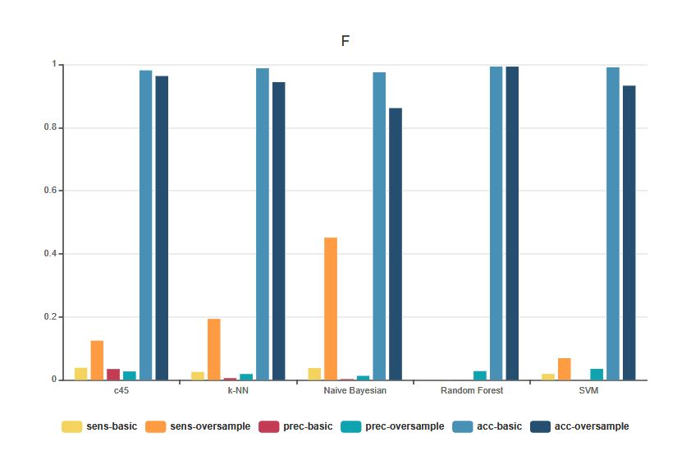
CLASSIFICATION: I - MODELS EVALUATION WITH BEAT AS DATA - MLII

Slide 14
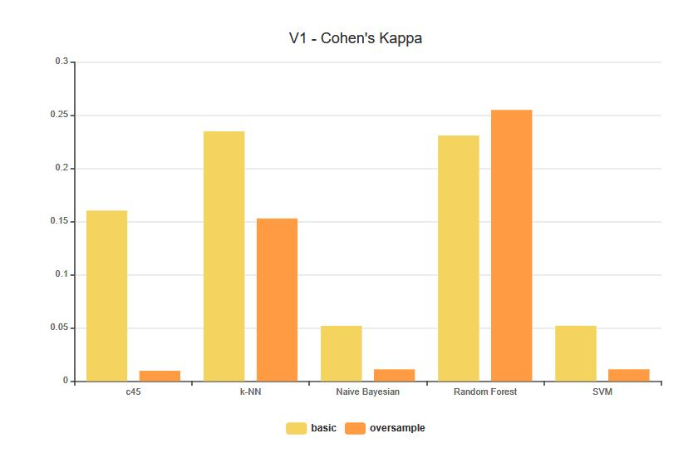
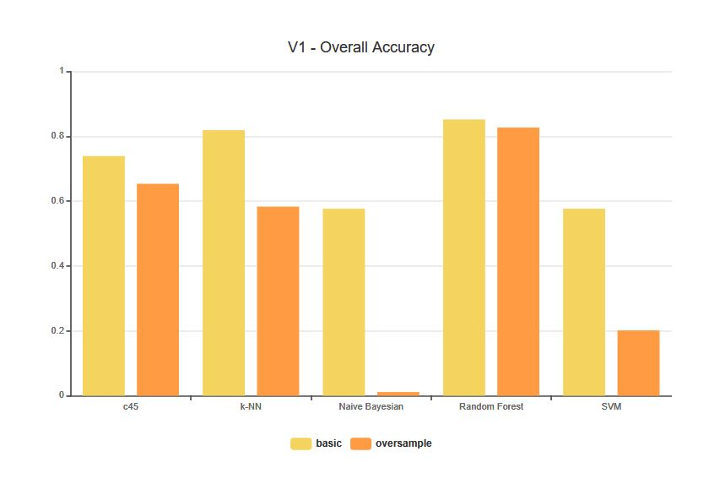
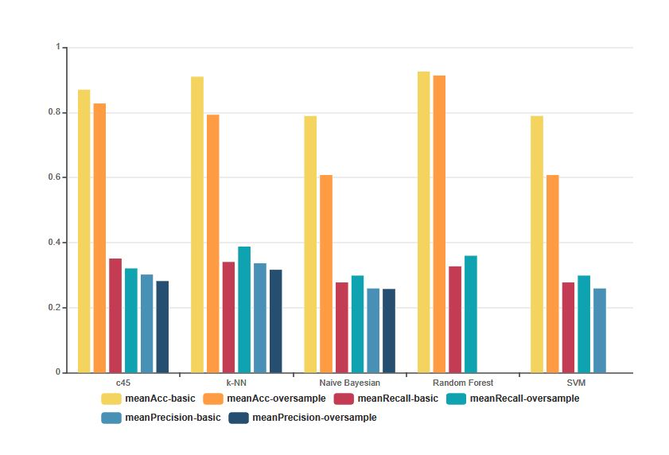
CLASSIFICATION: I - MODELS EVALUATION WITH BEAT AS DATA - V1

Slide 15
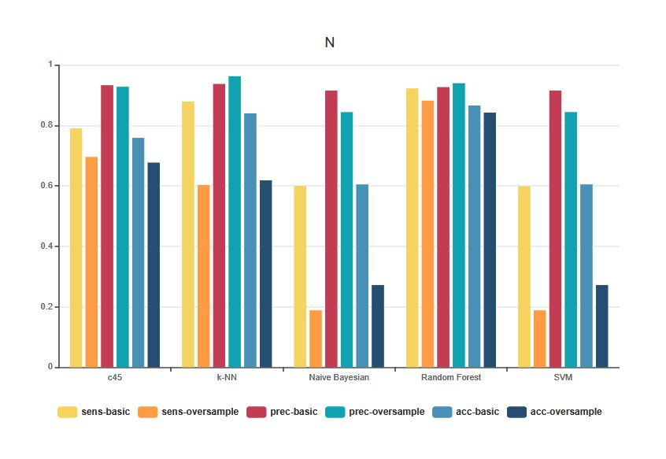
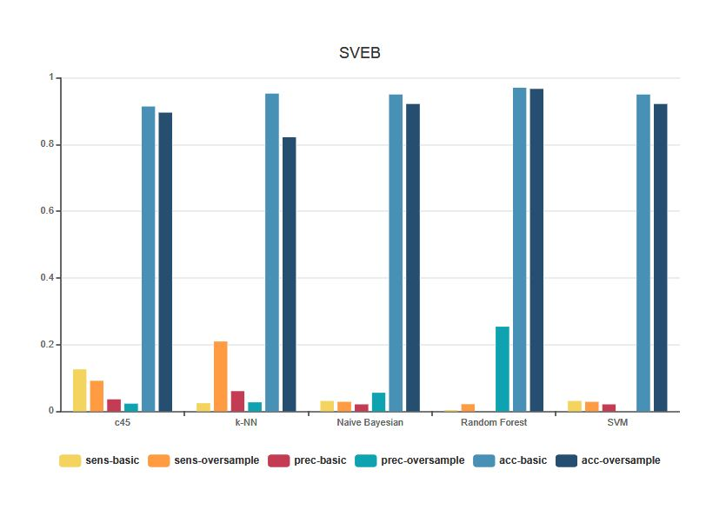
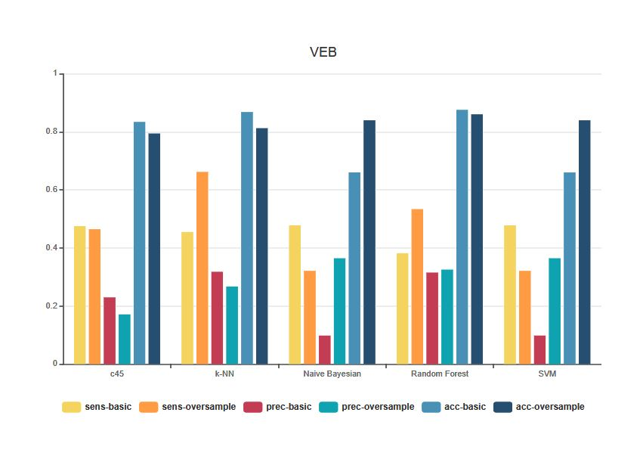
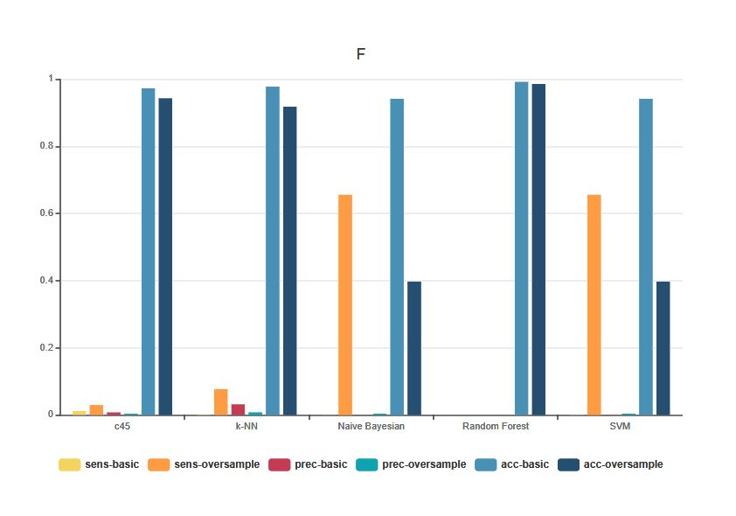
CLASSIFICATION: I - MODELS EVALUATION WITH BEAT AS DATA - V1

Slide 16
CLASSIFICATION: VOTING MODEL
In the second step we try to improve the performance of the classifications merging the previus steps.
Two kinds of approaches could be possible at this point:
Merge the two beats data and train a single model
Train two different models with the 2 kinds of beats and then perform a voting strategies on the results.
In this study the second option is choosed because each beat is represented as a vector of 360 values, so merging 2 beats imply training classifiers with vectors of 720 values as objects. The computational cost would be too high to handle and the traning phase too slow.
Each classification has been performed on a single beat record: so 2 models for classificator have been evaluated in order to have 2 distinct classifications for beat.
Then a voting step it is performed using a RandomForest decision tree on the classificators results.
MLII
CLASSIFICATION
OVERSAMPLING
CLASS1, CLASS2
CLASSIFICATION
V1
CLASSIFICATION
Classification Task

Slide 17
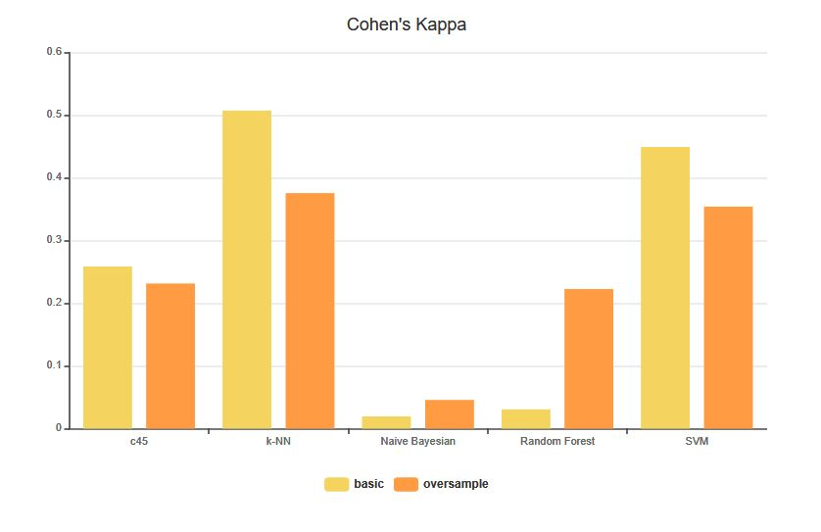
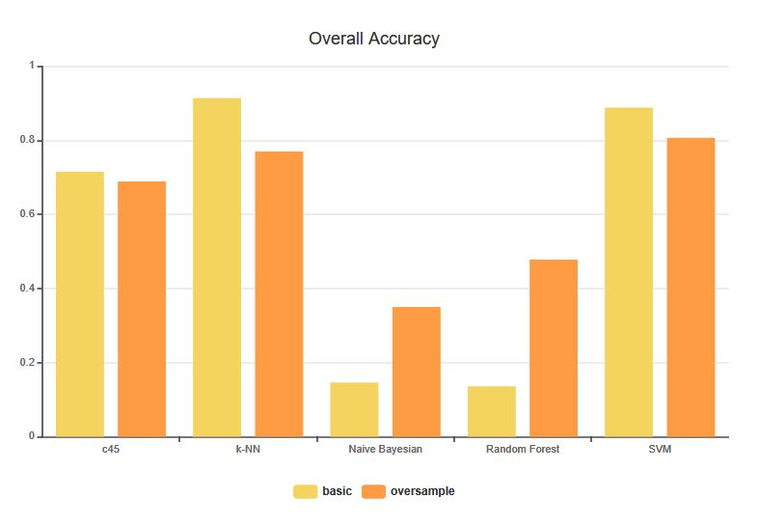
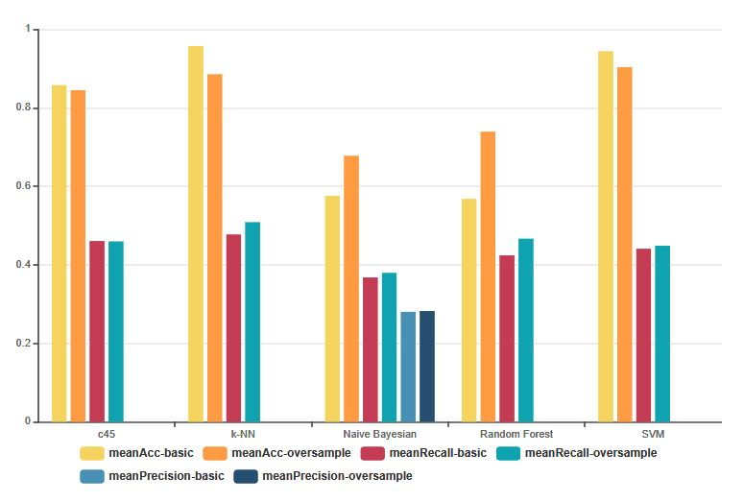
CLASSIFICATION: II - MODELS EVALUATION WITH BEAT AS DATA (1/2)

Slide 18
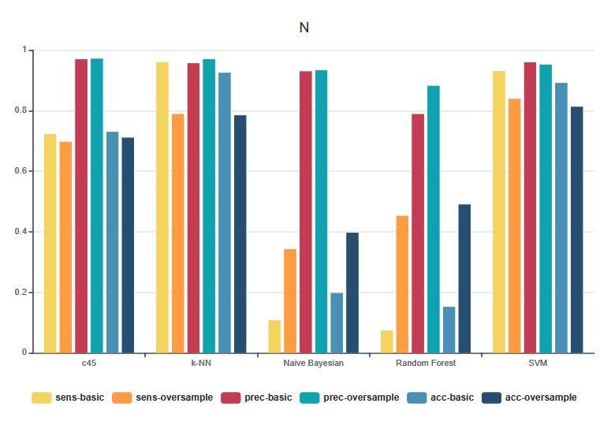
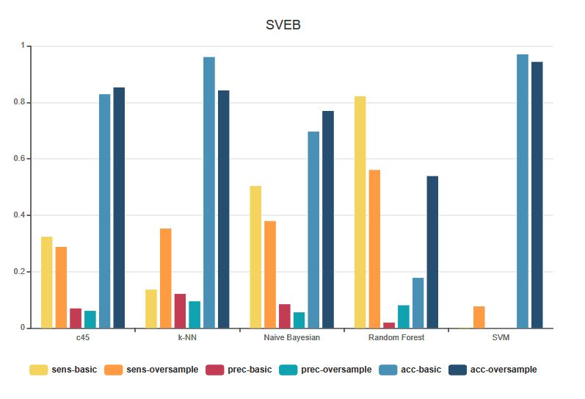
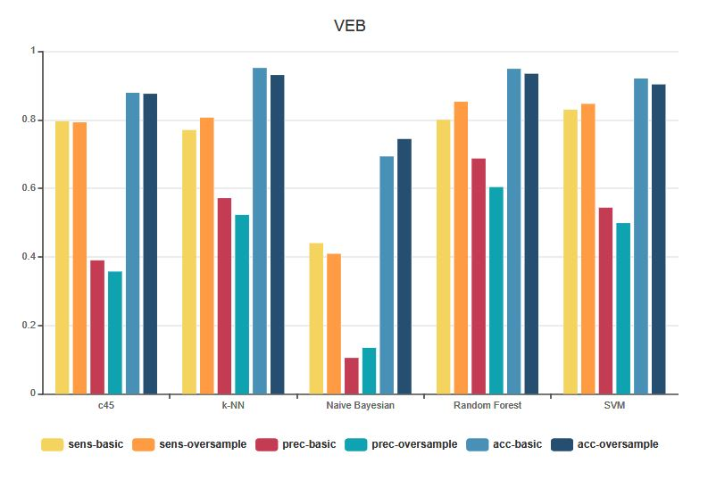
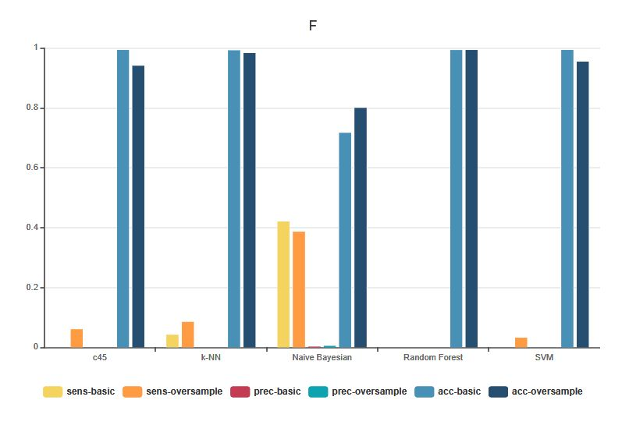
CLASSIFICATOIN: II - MODELS EVALUATION WITH BEAT AS DATA (2/2)

Slide 19
FEATURES SELECTION
Extraction, selection and reduction of the features from beats data

Slide 20
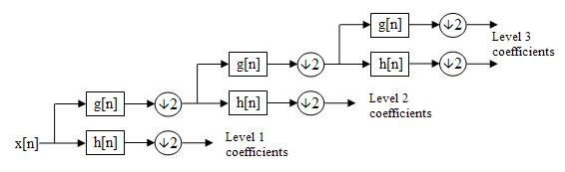
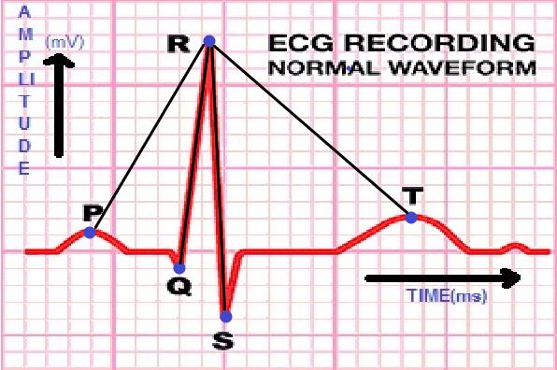
FEATURE SELECTION: EXTRACTION
In order to improve the classification results, a features selection step is provided, to avoid the curse of dimensionality and to send more significant data to the classifiers.
Both the MLII and V1 data were used to construct each features, so the previus voting strategies has been removed.
Wavelets:
The coefficient of detail and aproximation in the level 3
of the decomposition, related to the 0-45 Hz frequency
where most of the energy of the signal is located
HOS:
The union of the kurtosis and skewness value of each of the 5 intervals dividing a beat
Morphological Descriptor:
Euclidean distance between the R-peak and this four points in each beat:
Max (beat [0,40] )
Min (beat [75,85] )
Min (beat [95,105] )
Max (beat [150,180] )

Slide 21
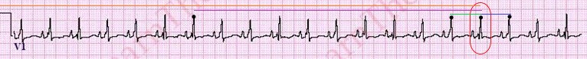
FEATURE SELECTION: EXTRACTION
Hbf5:
Coefficients, computed on each beat, of the Hermite series of degree 3, 4 and 5 that are the lest fit square
RR intervals:
A descriptor formed by 4 values:
Pre-RR: distance between the actual beat and the previous one
Post-RR: distance between the actual beat and the next one
Local-RR: average of the 10 previous Pre-RR values
Global-RR: average of the previous Pre-RR values produced in the last 20 minutes
LBP:
For each data point in a beat, a binary code is produced by the comparison of its value with the value of its neighbours. Then, an histogram that contains the frequency of each binary pattern is built

Slide 22
Feature SELECTION: EXTRACTION
For each beat there are calculate a number of 72 values that represent the sum of all the values calculated for each features.
So from 360 attributes for beat, with the features calculation it is passed to 72 values.
A feature selection phase is used in order to decrease again the number of data necessary to do the classification.
Two features selection method are used:
Info-gain
F-value
For each method a classification model is trained, using each time different number of features in order to find the best solution.
BEAT
Features calculation
BEAT
360 attributes
72 attributes

Slide 23
CLASSIFICATION
TRAIN MODELS WITH FEATURES AS input data

Slide 24
CLASSIFICATION: Data Mining FLOW
DATABASE
PREPROCESSING
FEATURES SELECTION
CLASSIFICATION
OVERSAMPLING
NORMALIZATION

Slide 25
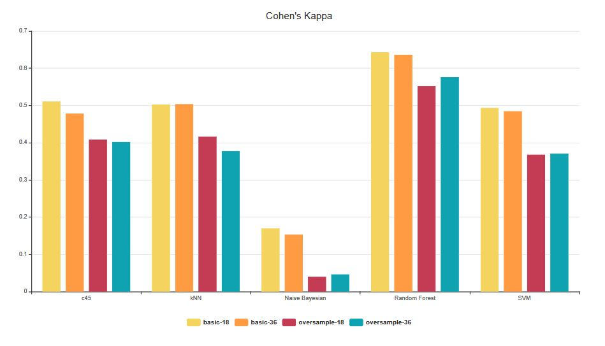
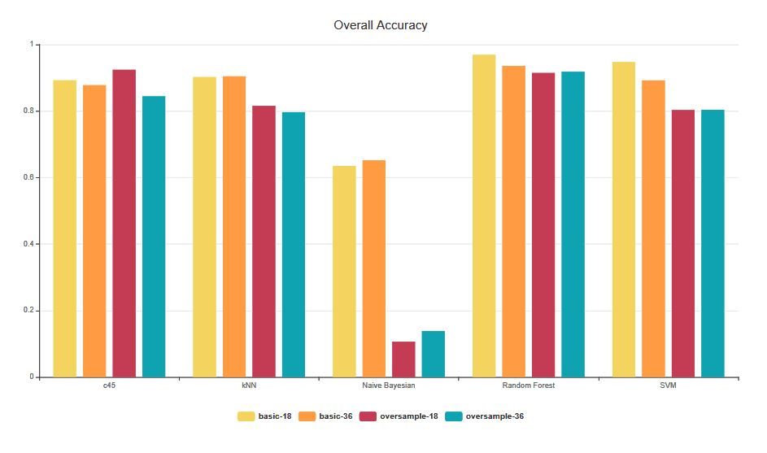
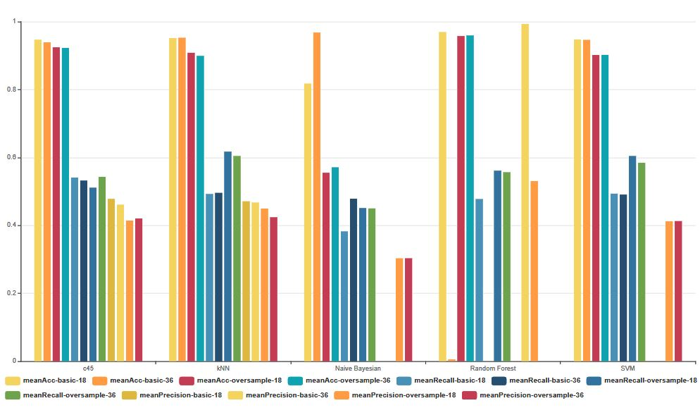
III - MODELS EVALUATION WITH FEATURES (1/2) - Info Gain

Slide 26
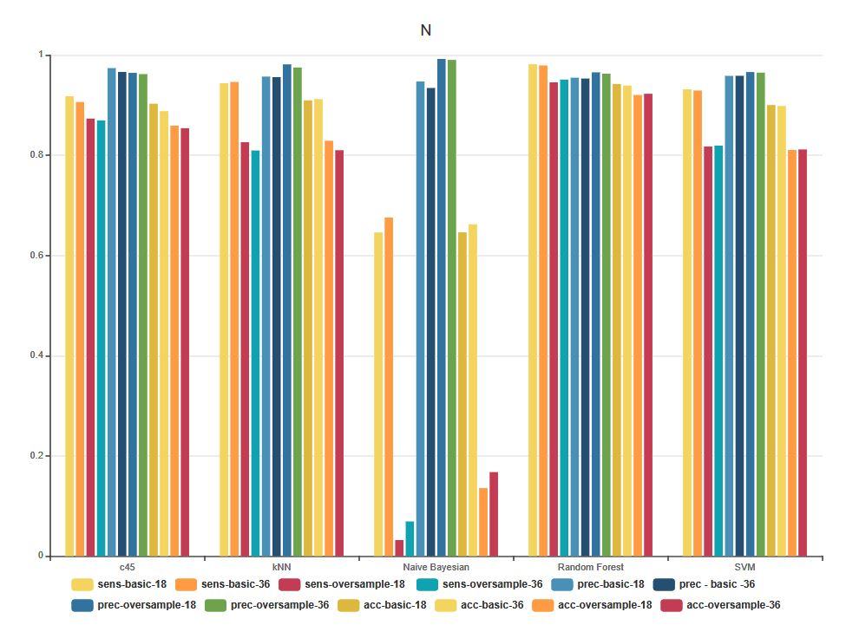
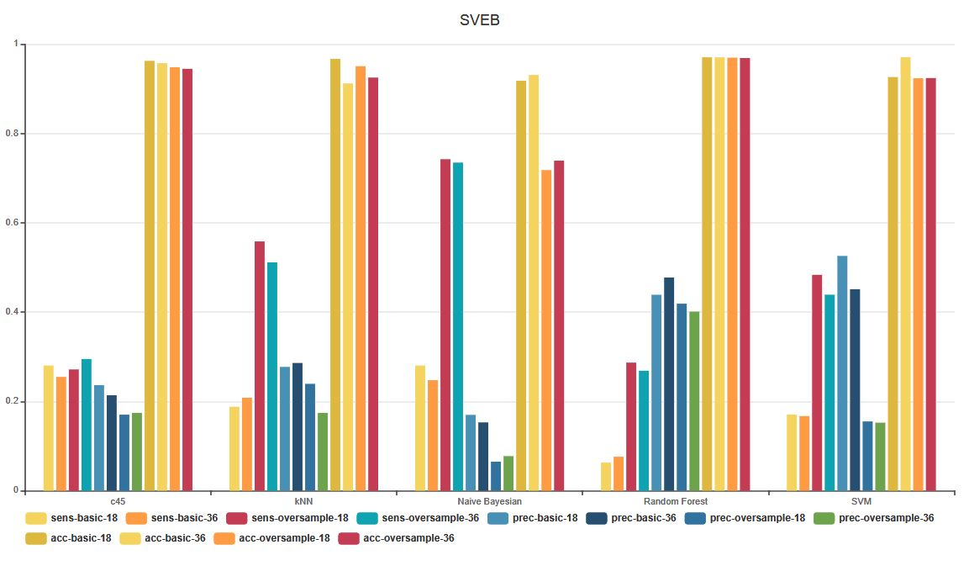
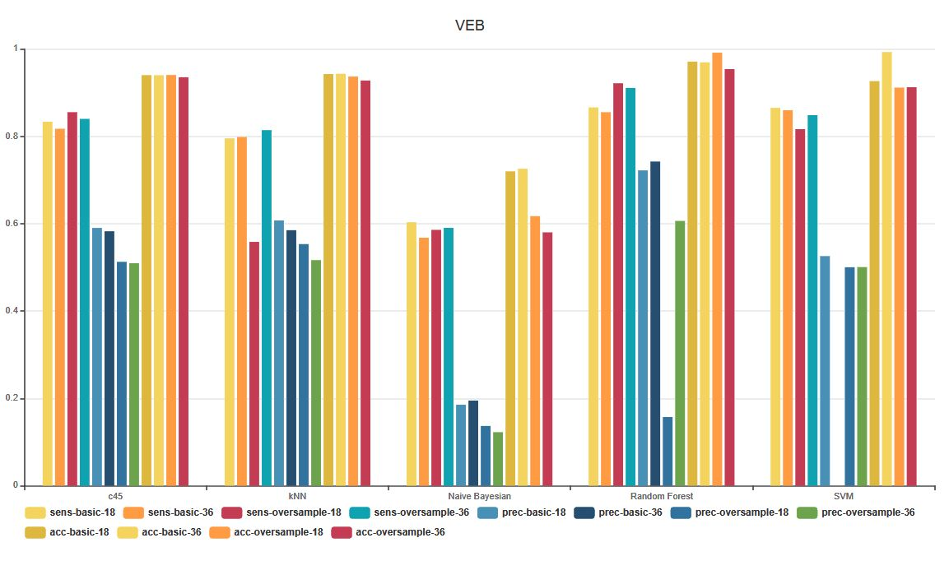
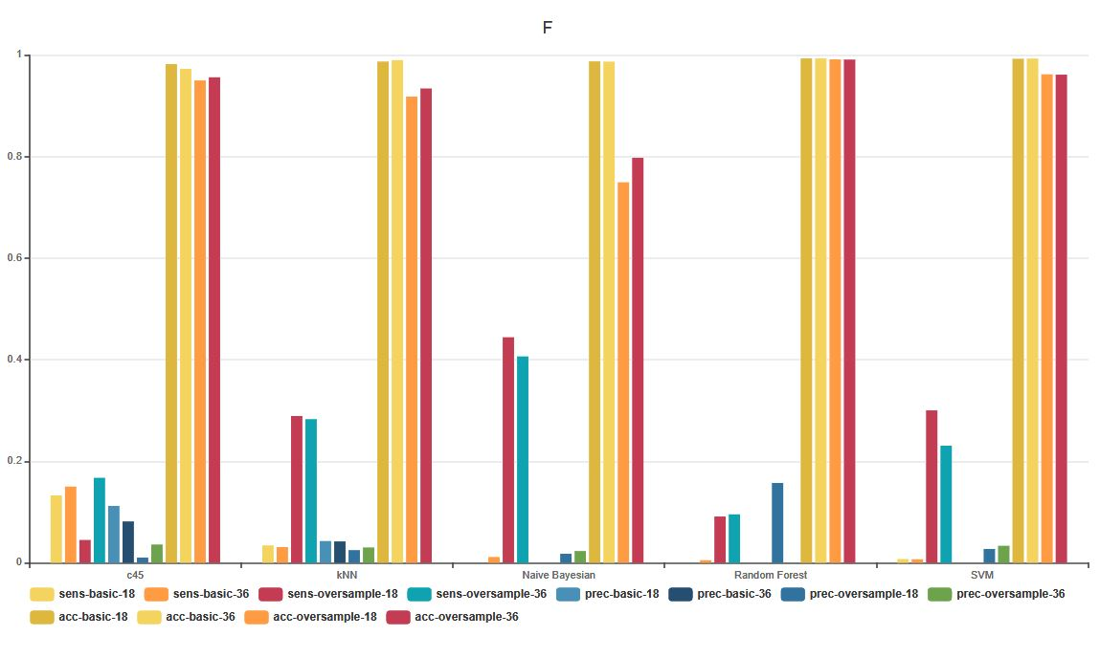
III - MODELS EVALUATION WITH FEATURES (2/2) – InFO GAIN

Slide 27
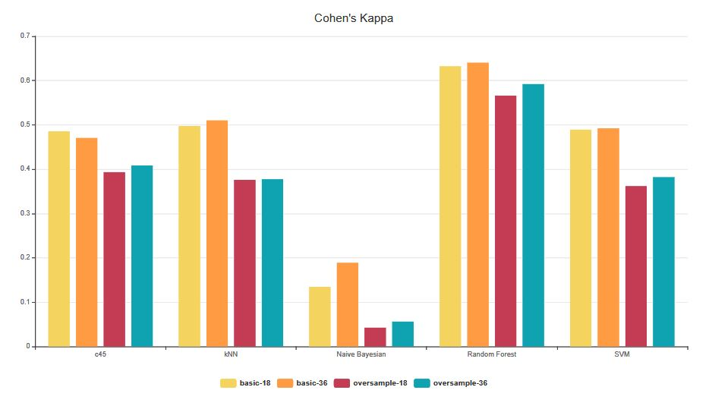
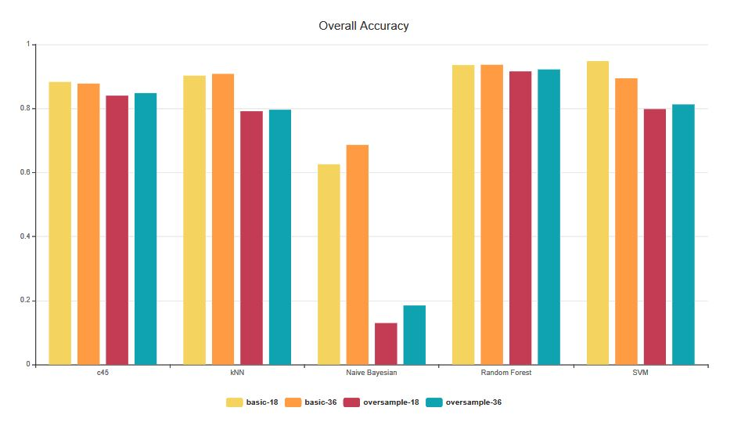
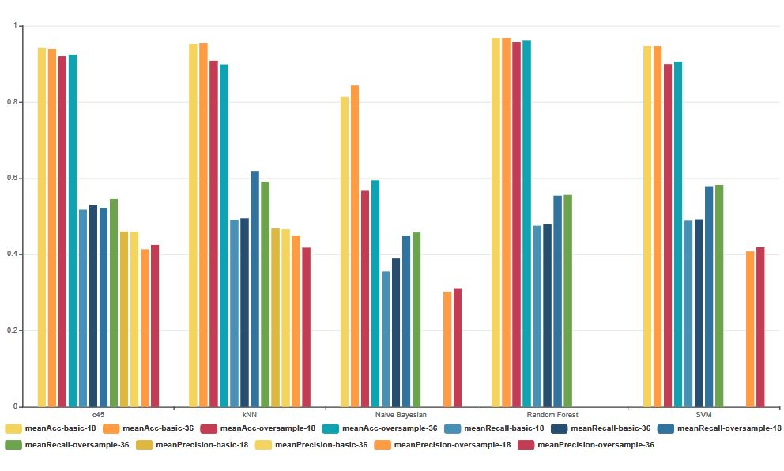
III - MODELS EVALUATION WITH FEATURES (1/2) - F Value

Slide 28
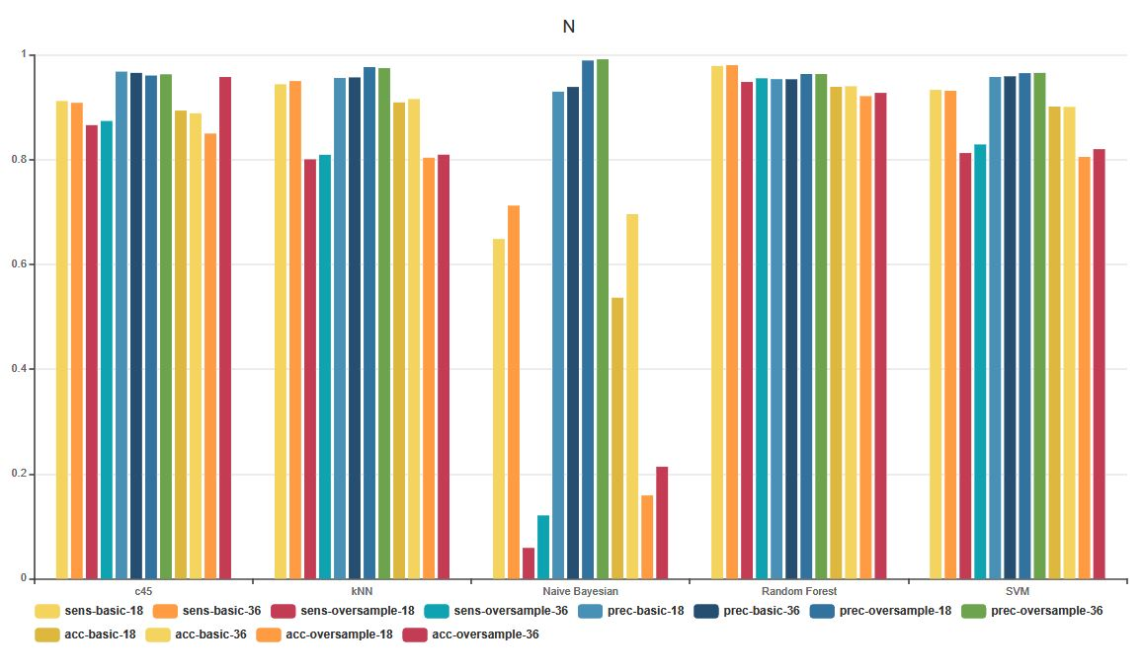
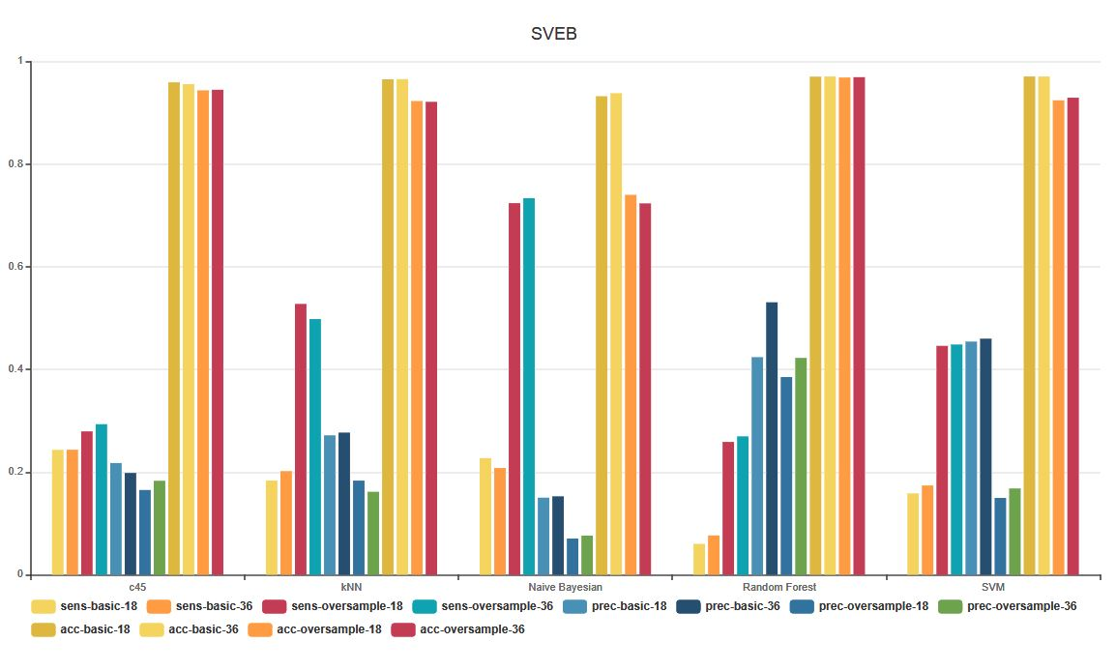
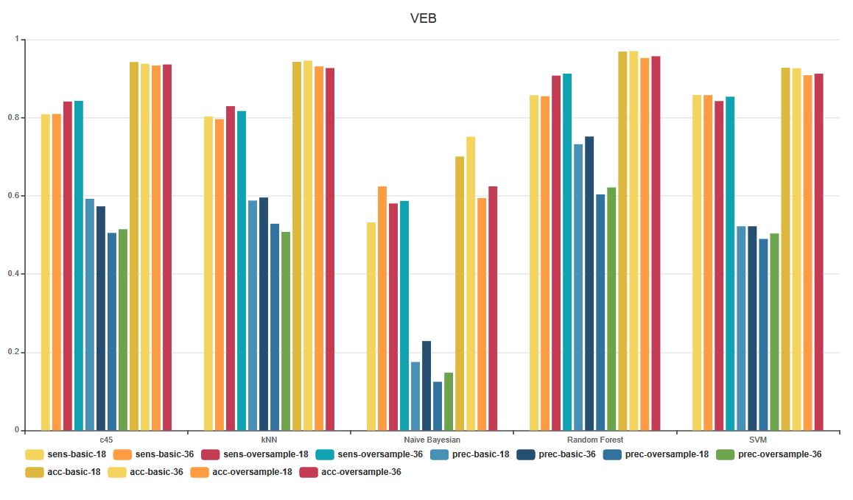
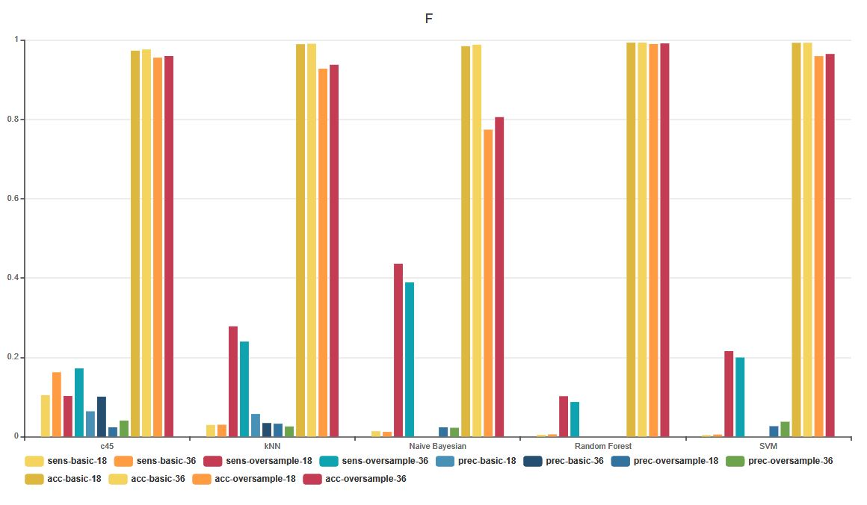
III - MODELS EVALUATION WITH FEATURES (2/2) – f Value

Slide 29
CLASSIFIERS EVALUATION

Slide 30
CLAssifiers Evaluation
Based on the results provided by the preavious section the two classifiers that has greater results are k-NN and SVM using info-gain as features selection method with 18 features.
Since that the database is highly unbalanced, we have considered the recall and precision score of each minority-class as parameter, because all the classifiers have good results with the classification of beats that belongs to class N.
In the next step the best classifier is evaluated using a t-test with the F2-score as parameter.

Slide 31
CLASSIFIERS EVALUATION: Student's t-test
F2 score table
 | SVM | k-NN
1-fold | 0,4067 | 0,3382
2-fold | 0,3230 | 0,2608
3-fold | 0,5596 | 0,57029
4-fold | 0,5729 | 0,5854
5-fold | 0,4623 | 0,5103
6-fold | 0,5268 | 0,6276
mean | 0,4752 | 0,4821
var | 0,001 | 0,022
P-value = 0,8054
T = 0,1504
T(alpha=0.5/2, d=5) = 2,571
So we can't conclude that the differences between SVM and k-NN are statistically significant.
Moreover k-NN is slower than SVM in predicting the results, for our pourpose we decided to use SVM.

Slide 32
Classifier evaluation: wilcoxon test
W+ = 5+4 = 9
W- = 1+2+3+6 = 12
W = min{W+, W-} = 9
k*(k+1)/2 = 21
(W+) + (W-) = 21
Wcrit = 0 ~ 2
k*(k+1)/2 = 21 > 20
Assume that the distribution is normal and evaluate the z-score:
meanw = 10,5
varw = 4,76
z-score = -0,3151
Area = 0,1255*2 = 0,251
P-value = 0,749
 | SVM | k-NN | di | rank | sign
1-fold | 0,4067 | 0,3382 | 0,0685 | 5 | +
2-fold | 0,3230 | 0,2608 | 0,06223 | 4 | +
3-fold | 0,5596 | 0,57029 | -0,01069 | 1 | -
4-fold | 0,5729 | 0,5854 | -0,0125 | 2 | -
5-fold | 0,4623 | 0,5103 | -0,048 | 3 | -
6-fold | 0,5268 | 0,6276 | -0,1008 | 6 | -

Slide 33
CLASSIFIER EVALUATION: VEB vs SVEB(1 / 2)
VEB
 | sens svm | prec svm | svm-f2 | sens k-nn | prec k-nn | k-nn f2
1-fold | 0,814 | 0,0818 | 0,2917 | 0,907 | 0,1099 | 0,3701
2-fold | 0,0847 | 0,1136 | 0,0892 | 0,1356 | 0,1151 | 0,1309
3-fold | 0,4732 | 0,165 | 0,3445 | 0,4732 | 0,1443 | 0,3250
4-fold | 0,7387 | 0,2033 | 0,4838 | 0,6376 | 0,2478 | 0,4850
5-fold | 0,5714 | 0,1082 | 0,3078 | 0,5262 | 0,1954 | 0,3931
6-fold | 0,2172 | 0,2564 | 0,2240 | 0,668 | 0,6206 | 0,657
 |  | mean | 0,2902 |  | mean | 0,3936
 |  | var | 0,0143 |  | var | 0,0254
pvalue = 0,19

Slide 34
CLASSIFIER EVALUATION: VEB vs SVEB(2/2)
SVEB
sens svm | prec svm | svm-f2 | sens k-nn | prec k-nn | k-nn f2
0,8592 | 0,1429 | 0,4290 | 0,7298 | 0,3895 | 0,6212
0,5298 | 0,0418 | 0,1588 | 0,4643 | 0,0358 | 0,1368
0,9111 | 0,9598 | 0,9204 | 0,923 | 1 | 0,9374
0,9032 | 0,9032 | 0,9032 | 0,9115 | 0,5199 | 0,7921
0,73 | 0,4178 | 0,6350 | 0,8627 | 0,5873 | 0,7887
0,9647 | 0,9421 | 0,9600 | 0,8773 | 0,784 | 0,8569
 | mean | 0,6677 |  | mean | 0,6888
 | var | 0,0869 |  | var | 0,07
pvalue = 0,7

Slide 35
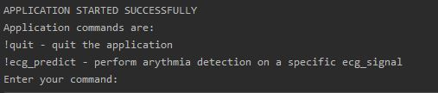
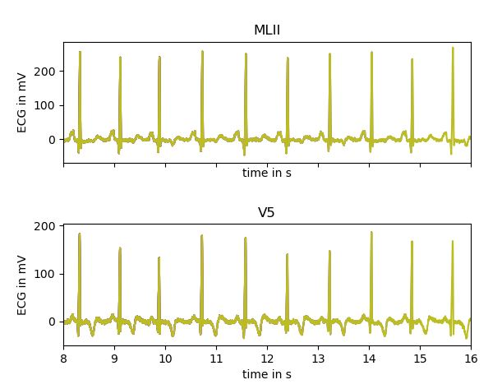
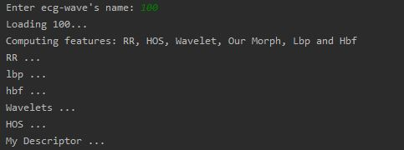
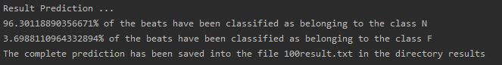
Program
Once the application has started, the user can request to analyze a specific ecg
First, the program will show the ecg wave on both MLII and V5
Then it will compute the features
And, show at video a summary of the prediction and save into a dedicated file the detailed results

